Slide 1
An Attention based Complex-valued Convolutional Autoencoder for GEO SA-Bi SAR Ship Target Refocusing
SAS2023
Miodrag Bolic, Meng Lian
Jul. 19. 2023
Notes:
note

Slide 2
CATALOGUE
O1
O2
O3
O4
O5
Introduction
Signal Model
Ship Target Refocusing based on an ICV-CAE
Experiments and
Analysis
Conclusion

Slide 3
Introduction
Ship targets are defocused due to heave motions caused by ocean waves, and contaminated by background clutter under rough sea conditions, high-resolution (HR) ship imaging is a great challenge in a Geosynchronous spaceborne/airborne bistatic synthetic aperture radar (GEO SA-Bi SAR) system.
O1

Slide 4
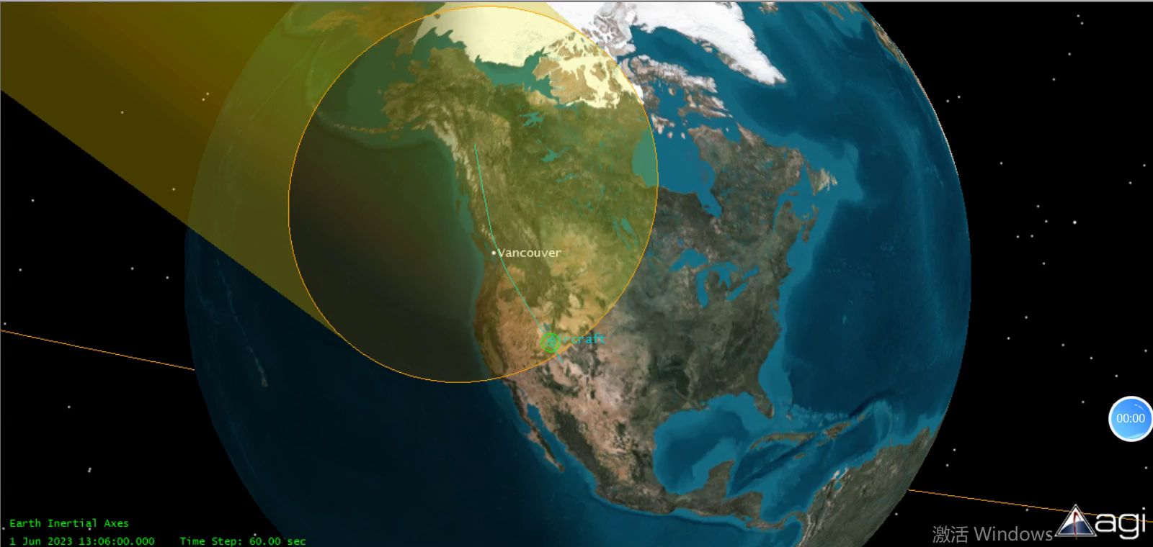
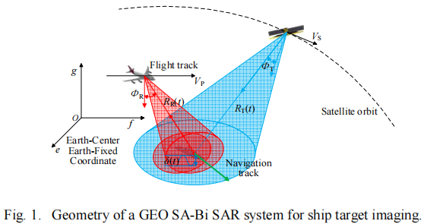
GEO SA-Bi SAR
Introduction
Transmitter: GEO satellite
Receiver: Airborne platform
Signal: LFM
Imaging: Target/Scene
Geometry of a GEO Spaceborne/Airborne-Bistatic SAR system

Slide 5
Introduction
Challenges in GEO SA-Bi SAR Ship Target Refocusing
O1
O2
O3
High-resolution
Motion compensation
Deep learning
Target’s motion
Time-varying structure of platfrom
Rough sea condition
Periodic Doppler components
Time-frequency analysis method
Complexity and resource cost
Detail features
Sea clutter suppression
Nonstationary motion information

Slide 6

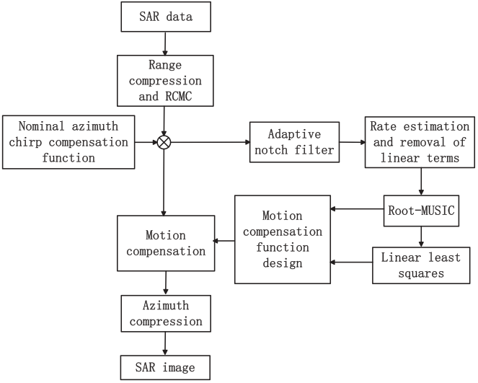
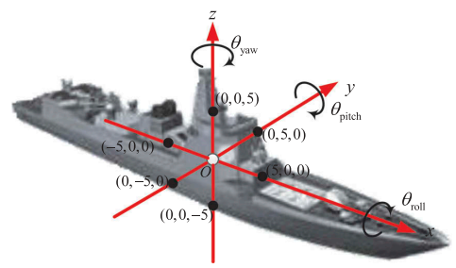
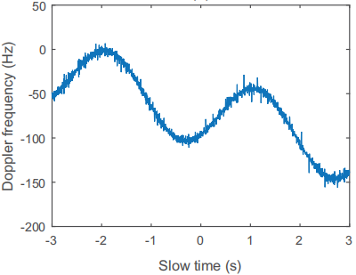
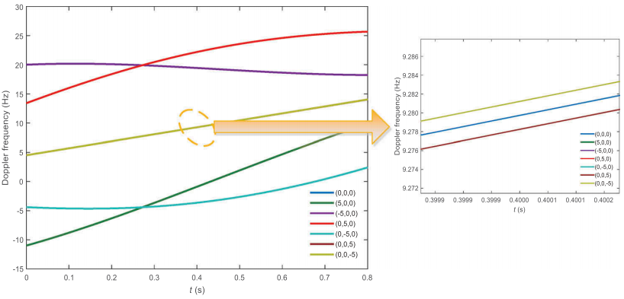
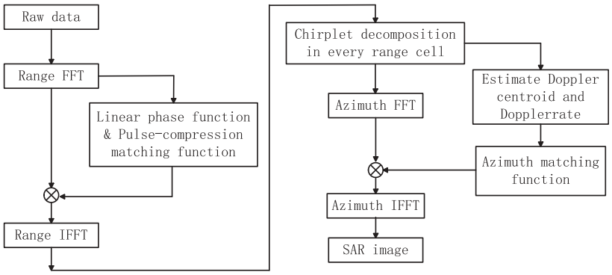
Methods we proposed previously
Introduction
Doppler histories of points on target
Influenced by heave and horizontal motion
Target influenced
by waves
Lots of parameter estimation
and iteration are needed.
Influenced by rotation

Slide 7
Signal Model
As the baseline is time-varying, the equivalent principle of the antenna phase center (APC) cannot be employed in this configuration. Therefore, the range history need to be derived in two 2-D Cartesian coordinate system, respectively.
02

Slide 8
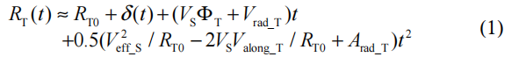
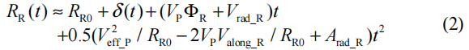
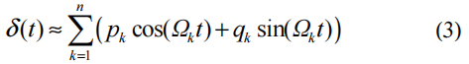
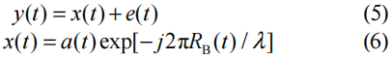
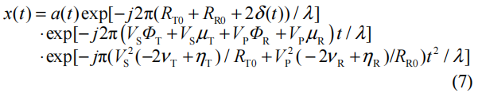
Signal Model
Transmitter’s distance to target:
Receiver’s distance to target:
Perturbation induced by waves:
Signal captured along the RCM line in the slow time-slant range domain:
After substituting normalized parameters and removing stationary target’s azimuth Doppler rate:

Slide 9


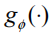

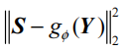
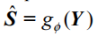
Signal Model
Conventional SAR imaging methods:
parameters estimation for compensate heave motion involves a large number of iterations!
From a regressive viewpoint:
S represents the refocused ship target image. Matrix Φ acts as a measurement matrix depending on target
unknown motion information and GEO SA-Bi SAR system parameters.
Inferring S from a gaven Y is a a blind ill-posed inverse problem.
Minimizing a pixelwise Euclidean loss:
Trained network:
act as:
Once, the optimal weights are learned, the refocused ship SAR image can be generated:

Slide 10
Ship Target Refocusing based on an ICV-CAE
First, the defocused images generated by our previous method are used as the network input. Then, the ground truth ship target images are generated in the almost same way, but with additional motion compensation. Finally, the well trained network can be regarded as a refocusing processor.
03

Slide 11
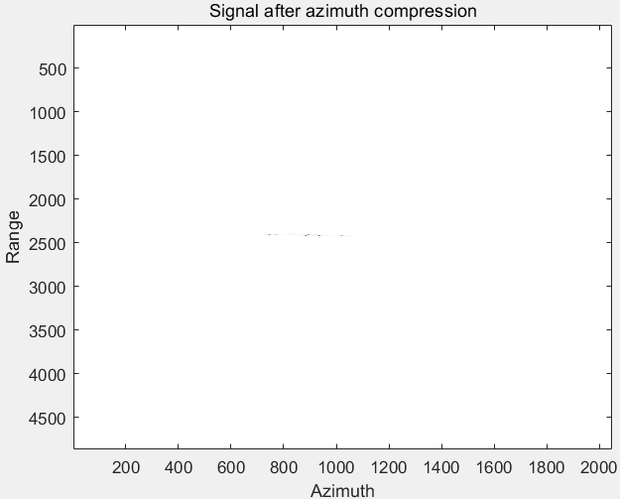
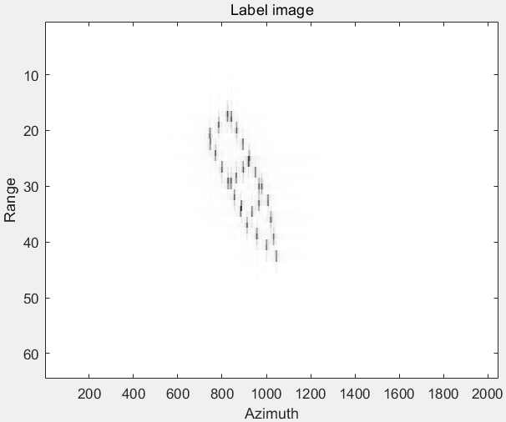
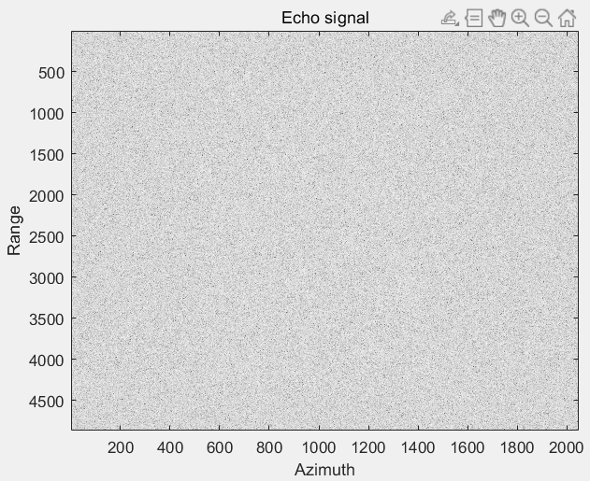
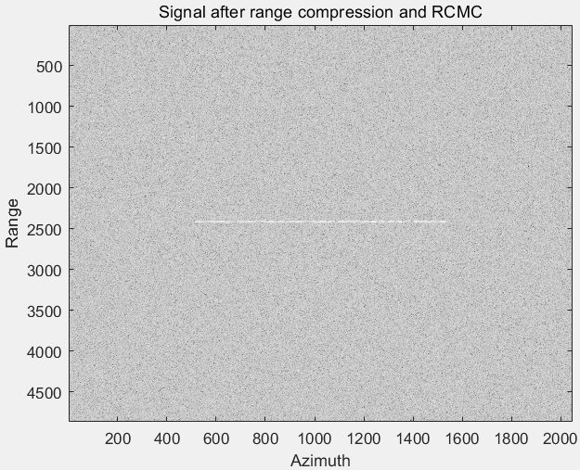
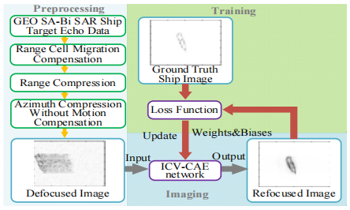
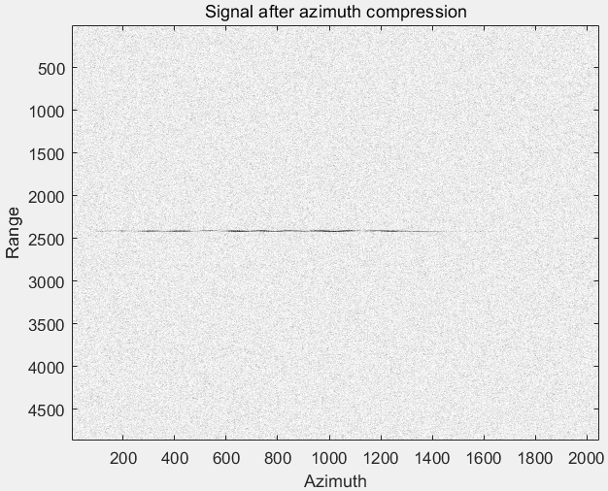
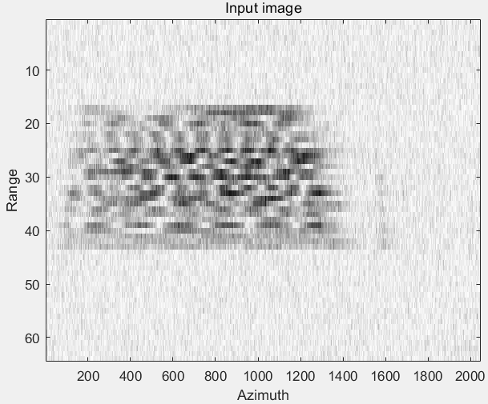
Signal after azimuth compression with compensation
(our method proposed previously)
A. Training Set Generation
Cropped
Echo signal
Used as groundtruth output (labels)
Signal after range
compression and RCMC
Compression
with compensation
Compression
without compensation
Cropped
Used as input
Flow chart of our method
Signal after azimuth compression without compensation

Slide 12
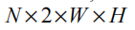

A. Training Set Generation
Divided into two channels which contain its real and imaginary part, respectively.
Amplitudes of images are normalized to a range of [0, 1] based on the min-max normalization strategy.
The ground truth SAR image used as label data should be cropped into the same size of the input, with only one channel.

Slide 13
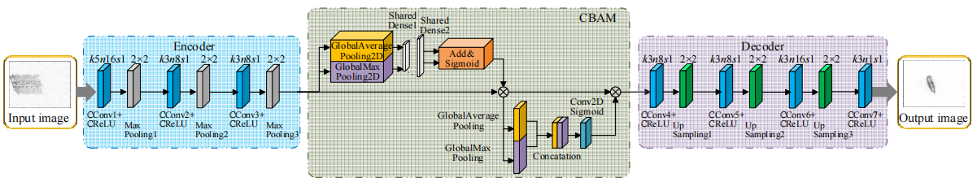
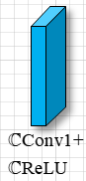
B. Network Architecture
Architecture of the proposed ICV-CAE network.
Channel 1: real part of the input complex matrix
Channel 2: imaginary of the input complex matrix
Channel 1: real feature
Channel 2: imaginary feature

Slide 14
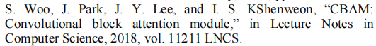
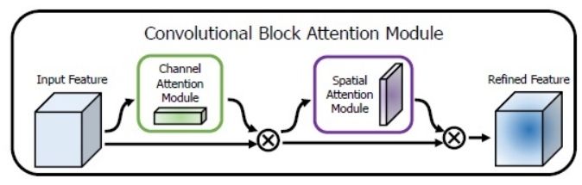
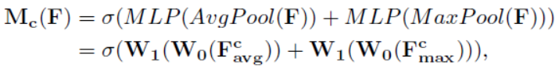
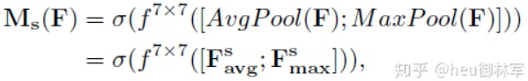

B. Network Architecture
GlobalAveragePooling feedbacks for all pixels
GlobalMaxPooling feedbacks for the max pixel
Architecture of the CBAM module.
used in CAM and SAM
Channel attention:
Spatial attention:
compressed in spatial dimension
compressed in channel dimension

Slide 15
Experiments and Analysis
The training is carried on a NVIDIA Quadro RTX 5000 GPU. The
optimizer is set to Adam with learning rate 10-2. Regarding the simulated dataset, it consisted of 24,000 training images, 6,000 validation images, and 6,000 testing images. The batch size is experientially set to a relative small number 32.
04

Slide 16
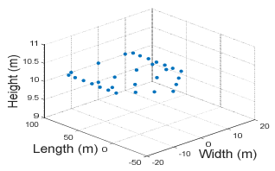
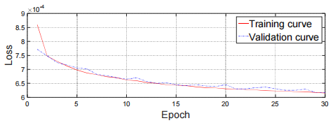
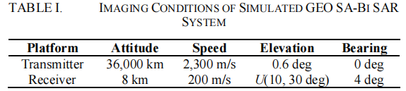
A. Training Details
Loss curves over epoches
Dot matrix of a ship target
System Metric | Value
Carrier frequency | 10GHz(X-band)
Pulse duration | 20μs
Bandwidth | 150MHz
PRF | 844Hz
SAT | 3s
Range resolution | 3.74m
Azimuth resolution | 4.51m
Target Metric | Value
Velocity | U(1, 20m/s)
Acceleration | U(0, 2m/s²)
Amplitude of reflection coefficients | U(0.8, 1.2)
SCNR | U(-30, -20dB)
Angle between velocity of ship and airplane | U(0, 60deg)
Amplitude of δ(t) | U(0, 2m)
Period of δ(t) | U(2, 4s)

Slide 17
B. Results on the simulated GEO SA-Bi SAR echo signal
Metric | Target 1 | Target 1 | Target 3
Velocity(m/s) | 12.2 | 8.1 | 10.5
Acceleration(m/s²) | 1.2 | 0.8 | 1.0
Amplitude of reflection coefficients | 1.1 | 0.9 | 1.1
Elevation angle(deg) | 20.5 | 10.3 | 25.7
SCNR(dB) | -22.7 | -25.7 | -27.2
Angle between velocity of ship and airplane(deg) | 21.4 | 10.7 | 30.2
Amplitude of δ(t) (m) | 0.3 | 1.2 | 1.6
Period of δ(t) (s) | 3.0 | 2.5 | 3.5
3 targets were simulated for illustration

Slide 18
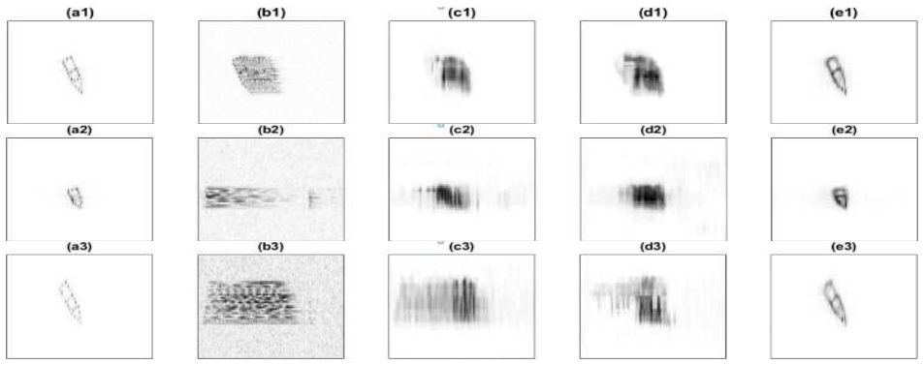
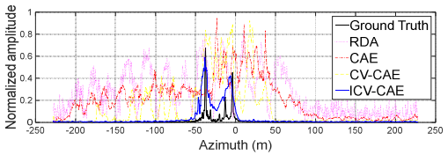
B. Results on the simulated GEO SA-Bi SAR echo signal
Column 1: GT images
Column 2: Results by RDA
Column 3: Results by CAE
Column 4: Results by CV-CAE
Column 5: Results by the proposed method
Metric | RDA | CAE | CV-CAE | ICV-CAE
Entropy | 6.540 | 5.056 | 3.881 | 2.137
SCNR(dB) | -17.32 | -2.77 | 3.76 | 7.91
Time(s) | 40.629 | 0.234 | 0.344 | 0.438
Azimuth responses of the range bin in scene center (Row 1)

Slide 19
Conclusion
In future work, the feasibility of integrating available SAR prior knowledge and collected data in our model to further improve its performance will be explored.
05

Slide 20
02
Conclusion
Training data
generation
Generate defocused and focused image pairs for training
Modeling
Train&Test
01
03
Utilize SAR prior knowledgeto to establish signal model
Build, train and test the proposed ICV-CAE network

Slide 21
THANKS
1 0 0 1 1 0 1
1 1 0 0 0 0 1
1 1 1 1 0 0 1
0 1 0 0 0 0 0
1 1 1 0 1 0 0
1 1 0 1 0 0 0
1 1 0 0 1 0 1
0 1 0 0 0 0 0
1 1 0 0 1 1 0
1 1 0 1 1 1 1
1 1 1 0 0 1 0
1 1 0 0 0 1 1
1 1 0 0 1 0 1
0 1 0 0 0 0 0
1 1 0 0 0 1 0
1 1 0 0 1 0 1
0 1 0 0 0 0 0
1 1 1 0 1 1 1
1 1 0 1 0 0 1
1 1 1 0 1 0 0
1 1 0 1 0 0 0
0 1 0 0 0 0 0
1 1 1 1 0 0 1
1 1 0 1 1 1 1
1 1 1 0 1 0 1

